Slide 1
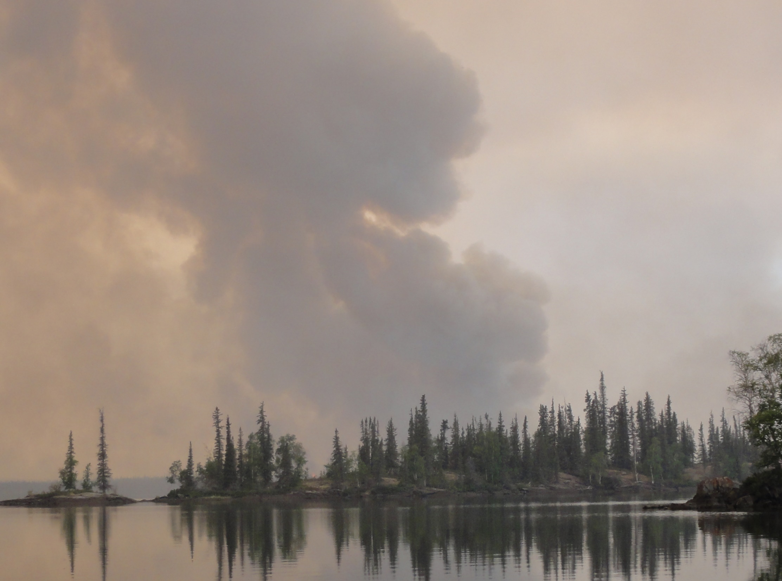
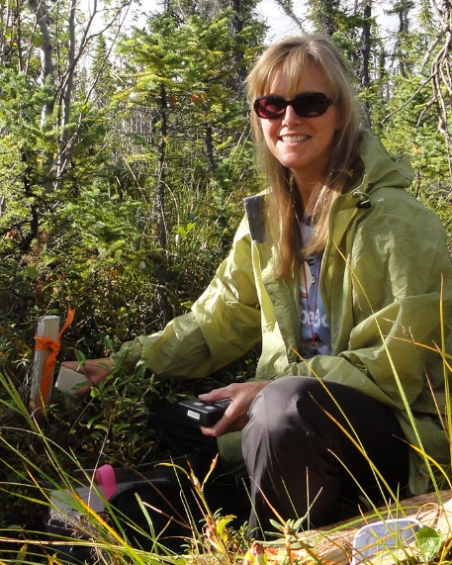
Understanding the Interactions between Wildfire Disturbance, Landscape Hydrology and Post-Fire Recovery in Boreal-Taiga Ecosystems
PI: Dr. Laura Bourgeau-Chavez
Co-Is: Dr. Nancy HF French, Michael Battaglia (MS), and
Michael Billmire (MS)
Michigan Technological University (MTU) Michigan Tech Research Institute, Ann Arbor, MI
Dr. Evan Kane
MTU School of Forest Resources and Environmental Science
Institutional PIs & Co-Is:
Dr. Jacquelyn Shuman, Dr. Sean Swenson UCAR
Dr. Paul Siqueira University of Massachusetts

Slide 2
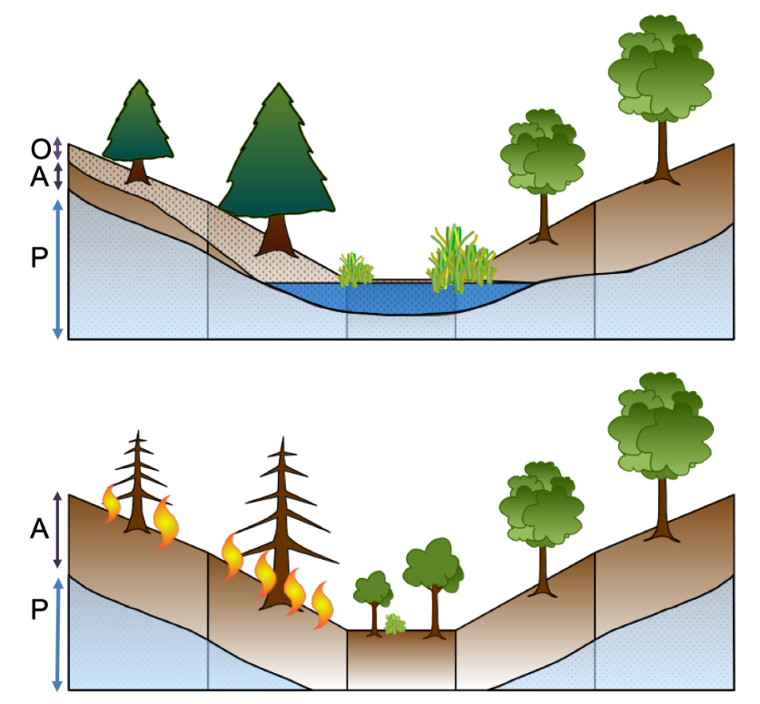
Elevator Speech- Science Obj. 1
(Bourgeau-Chavez TE 2018)
Wildfire and permafrost thaw are the first and second most prevalent disturbance factors in boreal North America. AND there is evidence that climate change is exacerbating both of these variables and the feedbacks between them. AND the ensuing hydrologic changes (some locations will be drier and some wetter) across the landscape have implications for future fire regimes and ecosystem successional trajectories.
BUT currently the interaction of fire with belowground processes is poorly, if at all, represented in models.
THEREFORE, to better understand, diagnose and predict ecosystem dynamics, especially the interaction of hydrology with wildfire and post-fire recovery, we will integrate field and remote sensing data observations with a landscape scale ecosystem model (FATES) that is coupled to a hydrological model, Community Land Model (CLM) Hillslope Hydrology (HH).
FATES-CLM-HH pre-disturbance
FATES-CLM-HH post-disturbance

Slide 3
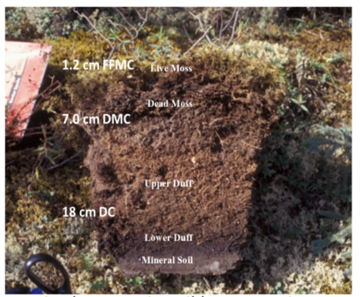
Science Objective 2
(Bourgeau-Chavez TE 2018)
Organic soil moisture is a key driver in the vulnerability of landscapes to wildfire ignition, consumption during a fire and in post-fire successional trajectories,
BUT algorithms and products of field scale soil moisture represent a data gap.
THEREFORE, under this project we will pursue the development of effective microwave soil moisture retrieval algorithms from satellite and airborne L- and C-band systems.
Tier 2 Science Questions addressed:
(3.2) What processes are contributing to changes in disturbance regimes and what are the impacts of these changes?
(3.5) How are flora responding to changes in biotic and abiotic conditions and what are the impacts on ecosystem structure?

Slide 4
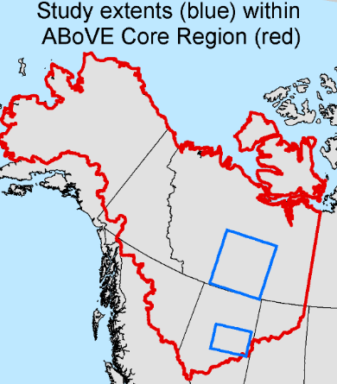
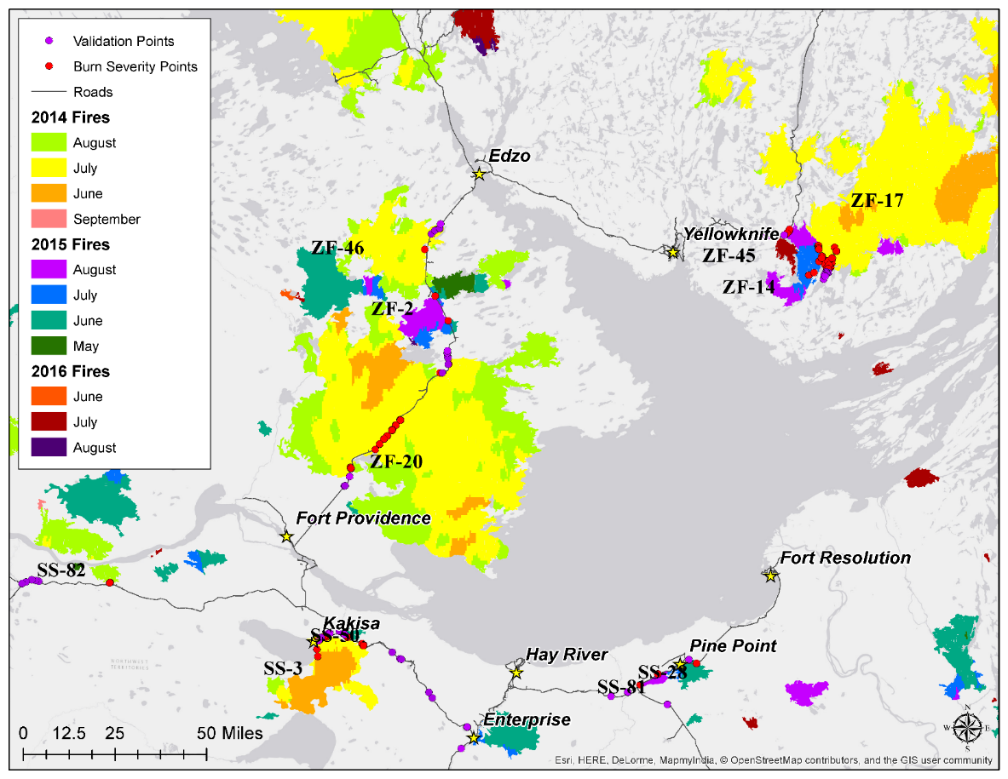
Field Studies
(Bourgeau-Chavez TE 2018)
85 burned & 67 unburned field sites from Bourgeau-Chavez TE2014 distributed in peatlands/uplands throughout study area. Existing measurements:
Burn severity canopy and peat -revegetation -fuel loading
Soil moisture -Active layer thickness -pre-burn forest inventory
New ground measurements & validation efforts focused on UAVSAR 2019-20/Radarsat-2:
field scale soil moisture
biomass (unburned sites and shrubby regrowth)
post-fire tree recruitment
data for model parameterization

Slide 5
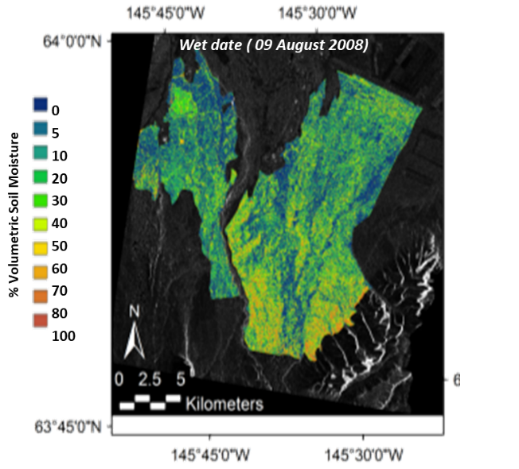
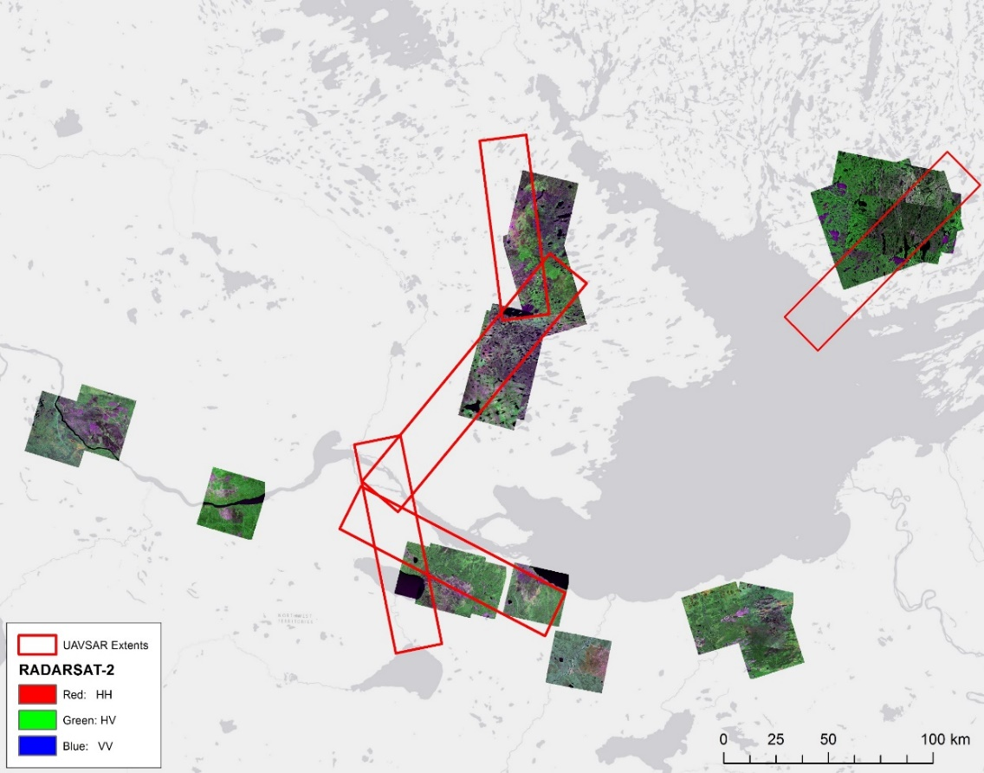
Remote Sensing
(Bourgeau-Chavez TE 2018)
Airborne remote sensing
UAVSAR L-band, focus on soil moisture and biomass retrievals
LVIS – for biomass
Spaceborne remote sensing
Radarsat-2
PALSAR-2
Acquisition Year | Radarsat-2 Images
2015 | 7
2016 | 9
2017 | 8
2018 | 6
Available Radarsat-2 images and UAVSAR flight lines (red boxes) for the study area.

Slide 6
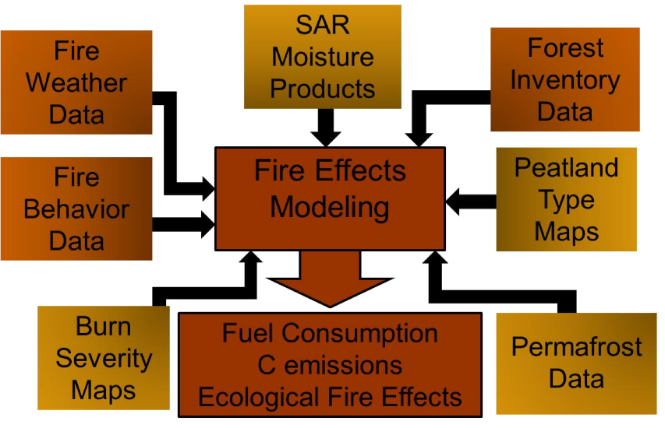
Modeling: CanFIRE, FATES-CLM-HH
(Bourgeau-Chavez TE 2018)
CanFIRE: will be parameterized for peatlands by integrating field and remote sensing data to estimate fuel loadings, quantify fire behavior and emissions
FATES-CLM-HH pre-disturbance
FATES-CLM-HH: simulate vegetation and permafrost response to site, climate and fire
FATES: size-structured vegetation
SPITFIRE: fire behavior and effects
CLM-HH: sub-grid hydrology with multiple hillslopes and lateral subsurface flow
O= organic layer, A= active layer, P = permafrost
FATES-CLM-HH post-disturbance
Notes:
Calibrate and assess FATES-CLM-HH with field and RS data. Validate against field, RS and CanFIRE C outputs. Measurements of burn severity, revegetation trajectory, active layer thickness, fuel loads biomass amounts and near surface soil moisture used to assess performance.
Paired simulations to evaluate effect of fire and assess feedbacks with vegetation and moisture conditions
Projections with future climate conditions.

Slide 7
Expected Products and Outputs
Planned Data Products:
Soil Moisture Retrieval Algorithms for L- and C-band
Soil Moisture Maps of NWT/Alberta Study area
Time series of ABZ tuned SMAP maps across the ABoVE domain
Calibrated/validated geospatial CanFIRE model for peatlands
allowing improvement in estimated C emissions
Calibrated/validated coupled FATES-CLM-HH model
Validated against field, RS and CanFIRE C outputs.
Paired simulations to evaluate effect of fire and assess feedbacks with vegetation and moisture conditions
Projections with future climate conditions.

